Slide 1


Shuvam Chakraborty
24.04.2025

Slide 2

Outline
Executive Summary
Introduction
Methodology
Results
Conclusion
Appendix

Slide 3
Executive Summary
Data Collection Methodology:
Collected data using SpaceX API and Wikipedia web scraping.
Data Wrangling:
Applied One-Hot Encoding to categorical features.
Cleaned data by handling missing values and duplicates.
Exploratory Data Analysis (EDA):
Visualized trends using histograms, bar charts, and scatter plots.
Used SQL queries to explore correlations and insights.
Interactive Visual Analytics:
Created interactive maps with Folium to visualize launch sites.
Developed a Plotly Dash dashboard for dynamic data exploration.
Predictive Analysis:
Built classification models (Logistic Regression, Random Forest, SVM, KNN) to predict launch success.
Model Building & Evaluation:
GridSearchCV for hyperparameter tuning.
Evaluated models using accuracy, precision, recall, and confusion matrix.

Slide 4
Introduction
Project background and context
SpaceX Launch Data: The project revolves around analyzing SpaceX launch data to predict the success of future missions.
Technologies Used: Utilized Python, Pandas, Scikit-learn, Plotly Dash, Folium, and SQL to analyze and visualize the data.
Objective: To understand launch success factors, predict the outcome of SpaceX launches, and provide insights into the operations of launch sites.
Problems you want to find answers
Launch Success Prediction: What factors contribute to a SpaceX launch being successful or unsuccessful?
Impact of Launch Site: Do different launch sites impact the success rate of launches?
Proximity to Infrastructure: Are launch sites in close proximity to railways, highways, or coastlines?
Geographical Factors: How do geographical features (latitude, longitude) influence launch success?
Performance of Models: Which classification models (Logistic Regression, SVM, etc.) perform best for launch success prediction?

Slide 5

Section 1

Slide 6
Methodology
Executive Summary
Data Collection Methodology:
Data was collected using the SpaceX API and web scraping from Wikipedia.
Data Wrangling:
Cleaned and transformed raw data for analysis.
Handled missing data, outliers, and irrelevant features.
Exploratory Data Analysis (EDA):
Used visualizations and SQL queries to explore patterns, trends, and relationships in the data.
Interactive Visual Analytics:
Used Folium to create interactive maps and Plotly Dash for visualizing trends and metrics.
Predictive Analysis:
Applied classification models to predict outcomes based on the available features.
Model Building, Tuning, and Evaluation:
Built classification models such as Logistic Regression, SVM, Decision Trees, and K-Nearest Neighbors.
Tuned hyperparameters using GridSearchCV.
Evaluated model performance using metrics such as accuracy, precision, recall, and F1-score.

Slide 7
Data Collection
The data was collected using various methods
Data collection was done using get request to the SpaceX API.
Next, we decoded the response content as a Json using .json() function call and turn it into a pandas dataframe using .json_normalize().
We then cleaned the data, checked for missing values and fill in missing values where necessary.
In addition, we performed web scraping from Wikipedia for Falcon 9 launch records with BeautifulSoup.
The objective was to extract the launch records as HTML table, parse the table and convert it to a pandas dataframe for future analysis.

Slide 8
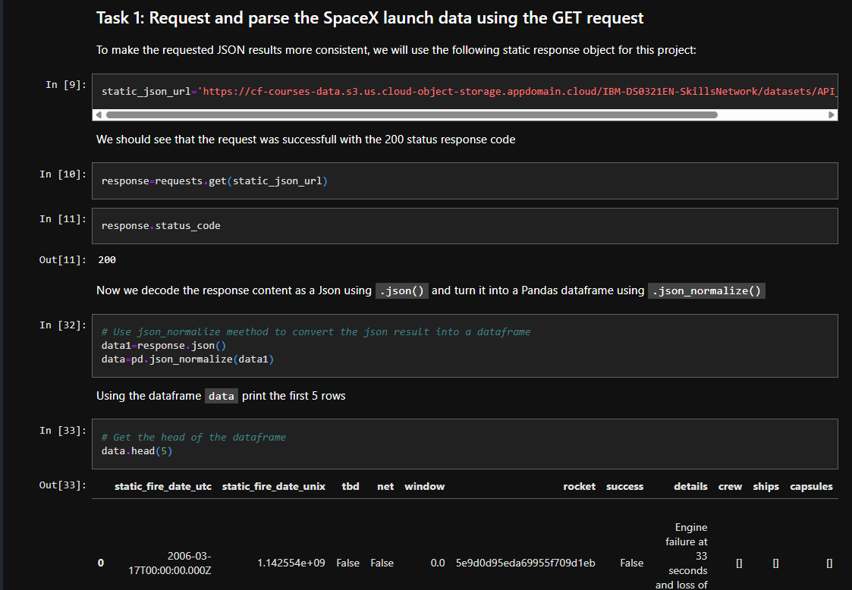
Data Collection – SpaceX API
Place your flowchart of SpaceX API calls here
We used the get request to the SpaceX API to collect data, clean the requested data and did some basic data wrangling and formatting.
The link to the notebook is https://github.com/ShuvamChakraborty-B/DataScience-Capstone/blob/main/jupyter-labs-spacex-data-collection-api.ipynb

Slide 9
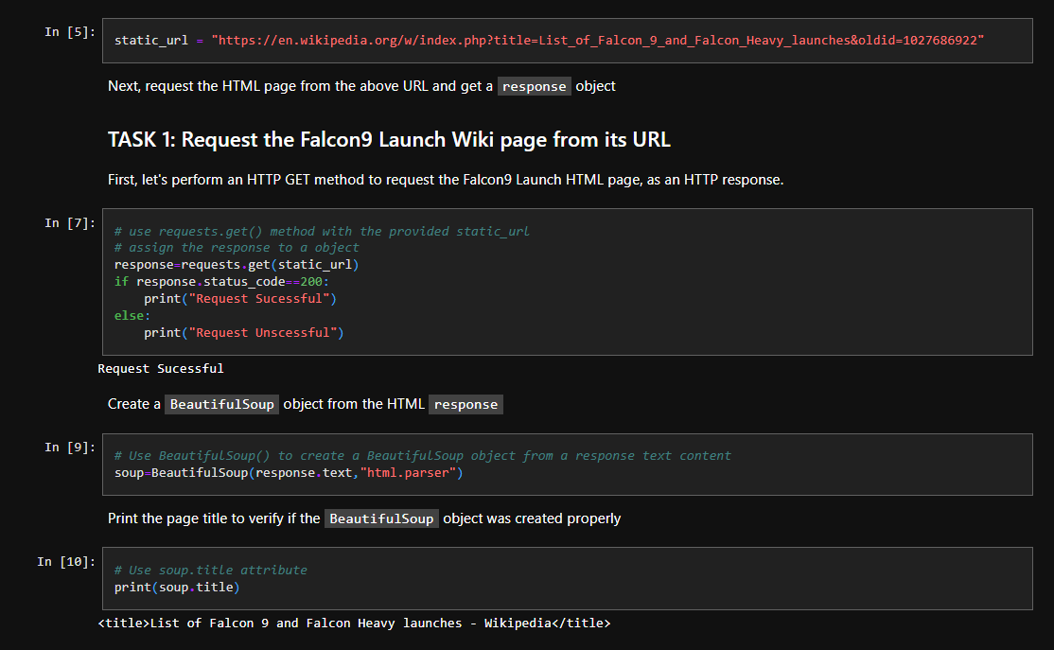
Data Collection - Scraping
We applied web scrapping to webscrap Falcon 9 launch records with BeautifulSoup
We parsed the table and converted it into a pandas dataframe.
The link to the notebook is https://github.com/ShuvamChakraborty-B/DataScience-Capstone/blob/main/jupyter-labs-webscraping.ipynb
Place your flowchart of web scraping here

Slide 10

Data Wrangling
We performed exploratory data analysis and determined the training labels.
We calculated the number of launches at each site, and the number and occurrence of each orbits
We created landing outcome label from outcome column and exported the results to csv.
The link to the notebook is https://github.com/ShuvamChakraborty-B/DataScience-Capstone/blob/main/labs-jupyter-spacex-Data%20wrangling.ipynb

Slide 11
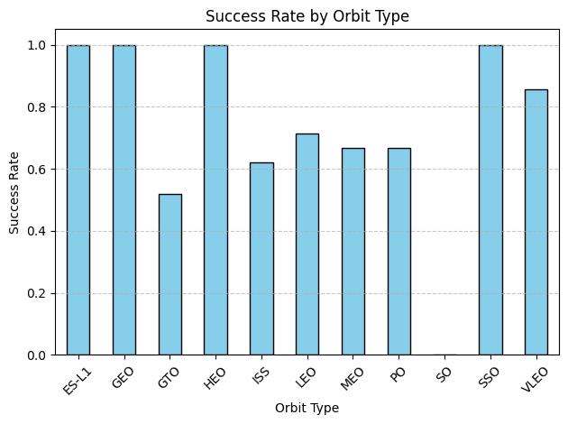
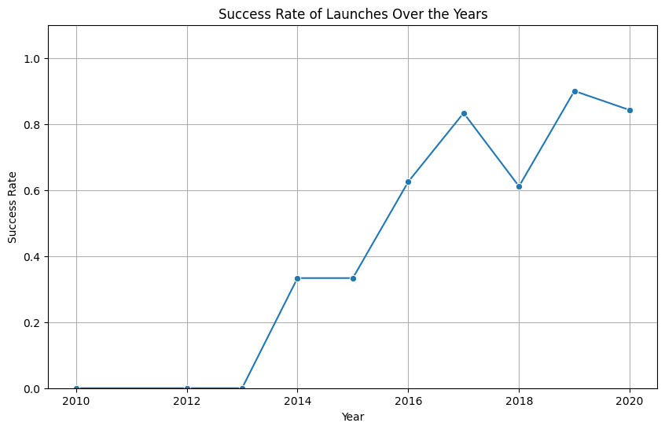
EDA with Data Visualization
We explored the data by visualizing the relationship between flight number and launch Site, payload and launch site, success rate of each orbit type, flight number and orbit type, the launch success yearly trend.
The link to the notebook is https://github.com/ShuvamChakraborty-B/DataScience-Capstone/blob/main/edadataviz.ipynb

Slide 12
EDA with SQL
We loaded the SpaceX dataset into a PostgreSQL database without leaving the jupyter notebook.
We applied EDA with SQL to get insight from the data. We wrote queries to find out for instance:
The names of unique launch sites in the space mission.
The total payload mass carried by boosters launched by NASA (CRS)
The average payload mass carried by booster version F9 v1.1
The total number of successful and failure mission outcomes
The failed landing outcomes in drone ship, their booster version and launch site names.
The link to the notebook is https://github.com/ShuvamChakraborty-B/DataScience-Capstone/blob/main/jupyter-labs-eda-sql-coursera_sqllite%20(2).ipynb

Slide 13
Build an Interactive Map with Folium
Key Features:
All SpaceX launch sites were plotted using folium map markers folium map markers..
Launch outcomes were labeled with color-coded markers:
Green → Success (1)
Red → Failure (0)
Marker clusters helped visualize which launch sites had relatively higher success rates.
Proximity & Location Analysis:
Measured distances from each launch site to nearby:
🚆 Railways
🛣️ Highways
🌊 Coastlines
🏙️ Cities
Answered key questions:
Are launch sites located close to railways, highways, or coastlines?
Are launch sites purposefully distant from populated urban areas?
Objective Achieved:
Combined interactive maps with analytical reasoning to better understand the geospatial factors influencing launch success.

Slide 14
Build a Dashboard with Plotly Dash
We built an interactive dashboard with Plotly dash
We plotted pie charts showing the total launches by a certain sites
We plotted scatter graph showing the relationship with Outcome and Payload Mass (Kg) for the different booster version.
The link to the notebook is https://github.com/ShuvamChakraborty-B/DataScience-Capstone/blob/main/dash.py

Slide 15
Predictive Analysis (Classification)
Model Development Process:
Data Preparation: Preprocessed dataset using One-Hot Encoding to convert categorical variables (e.g., launch site, orbit, booster version) into numerical format.
Model Selection: Applied and compared several classification models:
Logistic Regression
Support Vector Machine (SVM)
Decision Tree
K-Nearest Neighbors (KNN)
Model Tuning:
Used GridSearchCV with 10-fold cross-validation to find best hyperparameters.
Tuned parameters such as C, kernel, max_depth, and n_neighbors.
Model Evaluation:
Evaluated each model using metrics: ✔️ Accuracy ✔️ Confusion Matrix ✔️ Precision & Recall ✔️ ROC Curve & AUC Score
Best Performing Model: Identified the model with highest validation accuracy and balanced performance on the test set, which is Decision Tree
The link to the notebook is https://github.com/ShuvamChakraborty-B/DataScience-Capstone/blob/main/SpaceX_Machine%20Learning%20Prediction_Part_5.ipynb

Slide 16
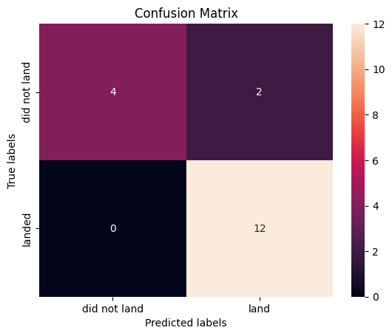
Results
📊 Objective: Build and evaluate classification models to predict launch success (1) or failure (0).
⚙️ Models Used:
Logistic Regression
K-Nearest Neighbors (KNN)
Support Vector Machine (SVM)
Decision Tree
🔧 Methodology:
Applied GridSearchCV for hyperparameter tuning
Used train-test split (80-20) for evaluation
Evaluated with accuracy, confusion matrix, ROC curve
🏆 Best Performing Model:
Decision Tree
Achieved ~88% accuracy on test data
Matrix for Decision Tree

Slide 17

Section 2

Slide 18
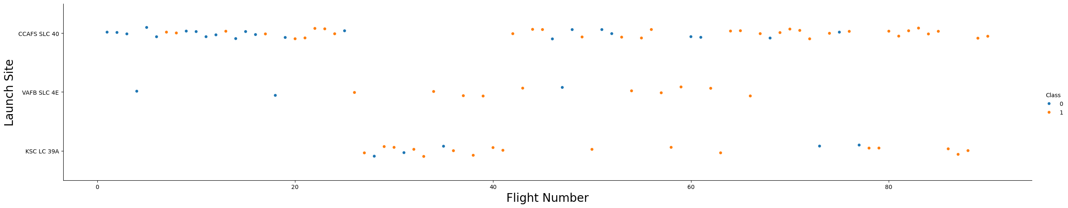
Flight Number vs. Launch Site
From the plot, we found that the larger the flight amount at a launch site, the greater the success rate at a launch site.

Slide 19
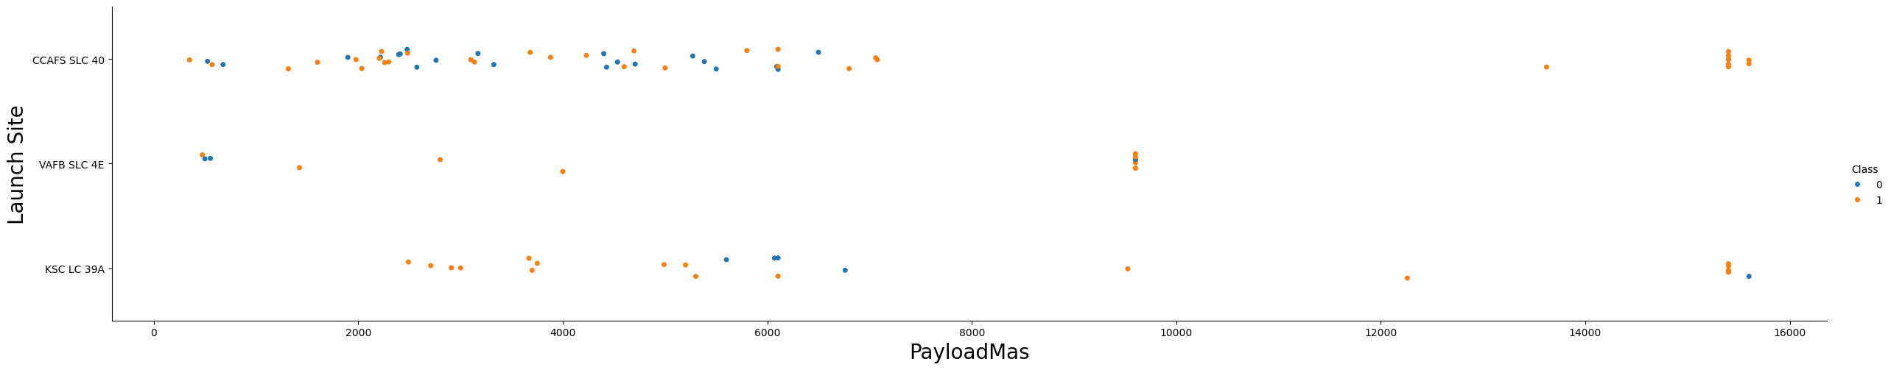
Payload vs. Launch Site
The greater the payload, the higher the success.

Slide 20
Success Rate vs. Orbit Type
From the plot, we can see that ES-L1, GEO, HEO, SSO, VLEO had the most success rate.

Slide 21
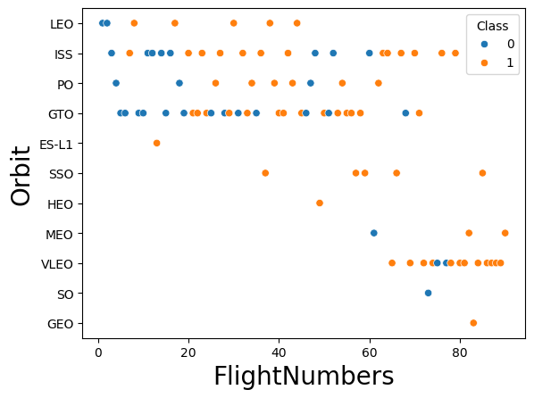
Flight Number vs. Orbit Type
The plot below shows the Flight Number vs. Orbit type. We observe that in the LEO orbit, success is related to the number of flights whereas in the GTO orbit, there is no relationship between flight number and the orbit.

Slide 22
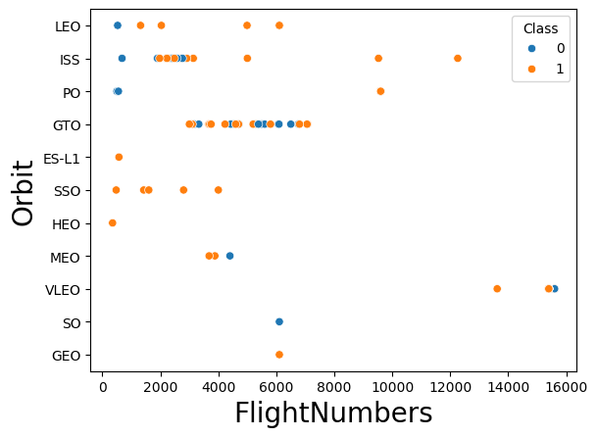
Payload vs. Orbit Type
We can observe that with heavy payloads, the successful landing are more for PO, LEO and ISS orbits

Slide 23
Launch Success Yearly Trend
From the plot, we can observe that success rate since 2013 kept on increasing till 2020.

Slide 24

All Launch Site Names
We used the key word DISTINCT to show only unique launch sites from the SpaceX data.

Slide 25

Launch Site Names Begin with 'CCA'
We used the query above to display 5 records where launch sites begin with `CCA`

Slide 26

Total Payload Mass
We calculated the total payload carried by boosters from NASA as 45596 using the query below

Slide 27

Average Payload Mass by F9 v1.1
We calculated the average payload mass carried by booster version F9 v1.1 as 2928.4

Slide 28

First Successful Ground Landing Date
We observed that the dates of the first successful landing outcome on ground pad was 22nd December 2015

Slide 29

Successful Drone Ship Landing with Payload between 4000 and 6000
We used the WHERE clause to filter for boosters which have successfully landed on drone ship and applied the AND condition to determine successful landing with payload mass greater than 4000 but less than 6000

Slide 30

Total Number of Successful and Failure Mission Outcomes
We used wildcard like ‘%’ to filter for WHERE MissionOutcome was a success or a failure.

Slide 31

Boosters Carried Maximum Payload
We determined the booster that have carried the maximum payload using a subquery in the WHERE clause and the MAX() function.

Slide 32

2015 Launch Records
We used a combinations of the WHERE clause, LIKE, AND, and BETWEEN conditions to filter for failed landing outcomes in drone ship, their booster versions, and launch site names for year 2015

Slide 33

Rank Landing Outcomes Between 2010-06-04 and 2017-03-20
We selected Landing outcomes and the COUNT of landing outcomes from the data and used the WHERE clause to filter for landing outcomes BETWEEN 2010-06-04 to 2010-03-20.
We applied the GROUP BY clause to group the landing outcomes and the ORDER BY clause to order the grouped landing outcome in descending order.

Slide 34

Section 3

Slide 35

All launch sites global map markers

Slide 36

Markers showing launch sites with color labels

Slide 37

Launch Site distance to landmarks

Slide 38

Section 4

Slide 39
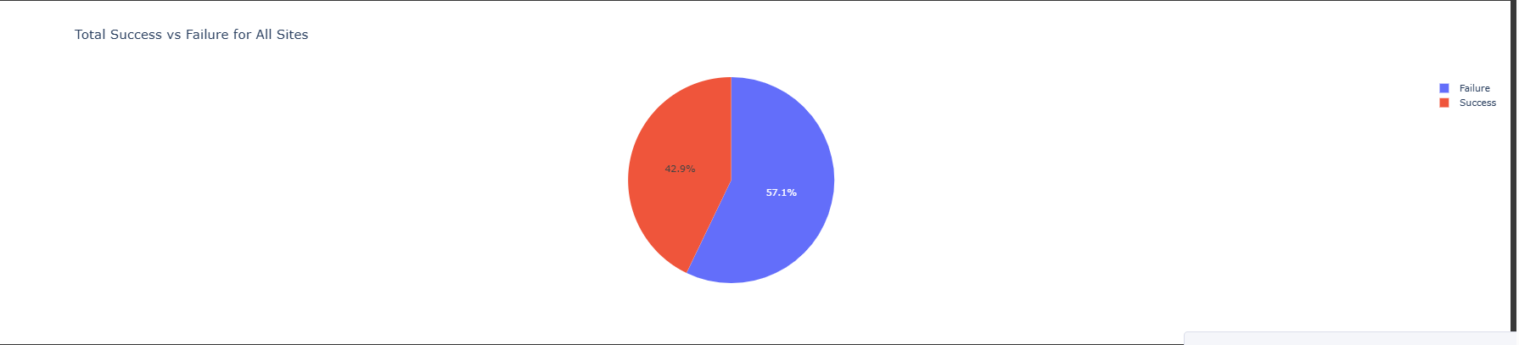
Total Success VS Failure of all sites

Slide 40
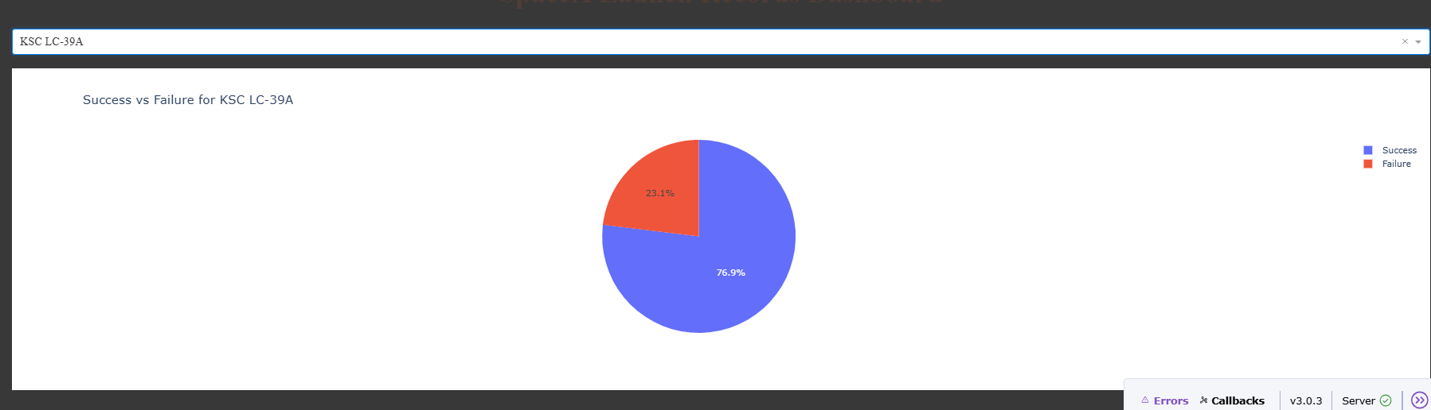
Pie chart showing the Launch site with the highest launch success ratio

Slide 41
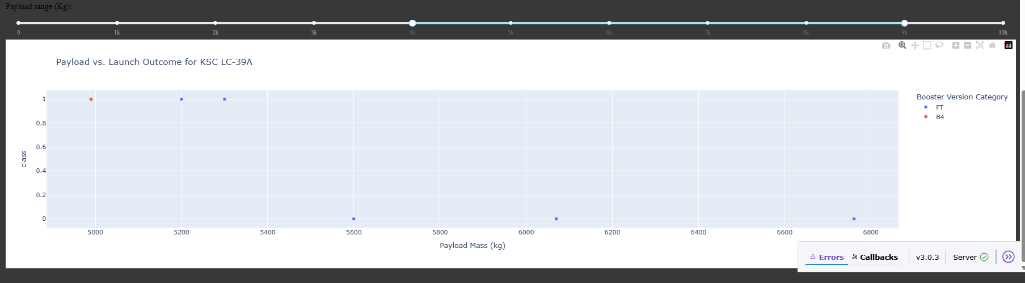
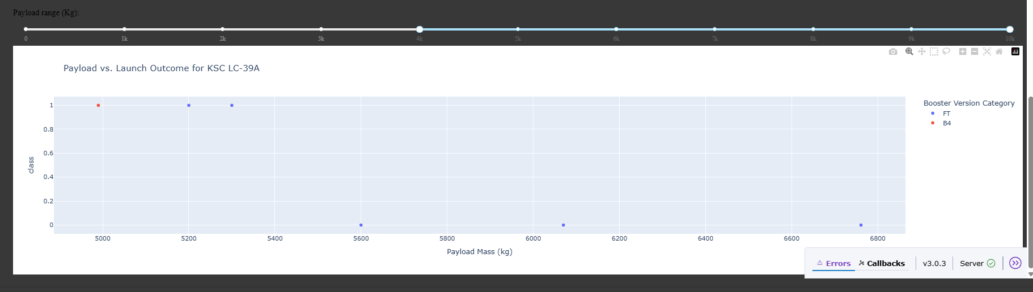
Scatter plot of Payload vs Launch Outcome for all sites, with different payload selected in the range slider

Slide 42

Section 5

Slide 43

Classification Accuracy
The decision tree classifier is the model with the highest classification accuracy

Slide 44
Confusion Matrix
The confusion matrix for the decision tree classifier shows that the classifier can distinguish between the different classes. The major problem is the false positives .i.e., unsuccessful landing marked as successful landing by the classifier.
Matrix for Decision Tree

Slide 45
Conclusions
We can conclude that:
The larger the flight amount at a launch site, the greater the success rate at a launch site.
Launch success rate started to increase in 2013 till 2020.
Orbits ES-L1, GEO, HEO, SSO, VLEO had the most success rate.
KSC LC-39A had the most successful launches of any sites.
The Decision tree classifier is the best machine learning algorithm for this task.

Slide 46


